Slide 1
COMPUTER HARDWARE COMPONENTS
CLASSIFICATION OF COMPUTER HARDWARE

Slide 2
The computer hardware of the computer system refers to the physical and the tangible parts of the computer system.The hardware of the computer can be divided into six main parts namely:
Input device
Processing device
Output device
Storage device
Communication devices
System Unit

Slide 3
INPUT DEVICES
This the process of capturing or collecting raw data into the form that is usable by the computer for processing.

Slide 4
FUNCTIONS OF INPUT DEVICES
They are used to enter data into the computer
They are used to make graphic designs
They are used to select command options
They are used to control the pointer on the monitor
Used to edit a text
They convert human readable form into computer readable form

Slide 5
CLASSIFICATION OF INPUT DEVICES
They can be classified under two sections:
Human Data Entry Devices
Source Data Automation

Slide 6
PROCESSING DEVICES
This refers to the performing of arithmetic solution ,sorting of lists,formatting documents,to arrive at the desired results.Processing of data in the computer in the computer is mainly done by the CENTRAL PROCESSING UNIT or the PROCESSOR

Slide 7
FUNCTIONS OF PROCESSING DEVICES
Transforming data into information
Interprets and carries out instructions that operate the computer
It controls and manages the operations of the computer

Slide 8
Output DEVICES
This is any hardware component that sends information out of the computer or provides the result of processing from the computer to the users.

Slide 9
FUNCTIONS OF OUTPUT DEVICES
Receive information from the computer
Convert computer readable form into human readable form

Slide 10
Storage devices
This is the tool that enables the user to either read or write from and unto the storage medium.Examples are CD ROM Drive,DVD ROM Drive etc.There are two types of storage media:
Primary(main) storage media
Secondary (backup) storage media

Slide 11
PRIMARY STORAGE MEDIA
This is a computer hardware that store instructions or data temporary.They usually consists of one or more chips on the motherboard in the computer.It is called the main memory or Immediate Access Store.It consists of Random Access Memory and Read Only Memory.

Slide 12
CHARACTERISTICS OF RANDOM ACCESS MEMORY
These are semi-conductor memories
It is a volatile memory
Data is lost in case power is switched off
A computer cannot run without it
Faster than secondary memories

Slide 13
TYPES OF RAM
STATIC RAM(SRAM)
DYNAMIC RAM(DRAM)
Static RAM indicates that the memory retains its contents as long as power is being supplied, however data is lost when the power gets down due to the volatile nature.

Slide 14
CHARACTERISTICS OF THE STATIC RAM
It has long life
There is no need to refresh
It is faster
Used as cashe memory
Large size
Expensive
High power consumption

Slide 15
DYNAMIC RAM (DRAM)
DRAM unlike SRAM must be continually refreshed in order to maintain the data.
Characteristics Of The Dynamic RAM:
It has short data life time
Slower as compared to SRAM
Lesser in size
Less expensive
Less power consumption

Slide 16
FUNCTIONS OF PRIMARY STORAGE MEDIA
They store instructions or data temporary
They store data that are about to be process
They are volatile,data is lost when power to computer is off
They store running application programs
They store data that has been process

Slide 17
SECONDARY STORAGE DEVICE
They are computer hardware that store copies of the original data or information.They use storage device to store data on them.Examples are hard disk,CDs,DVDs and floppy disk

Slide 18
TYPES OF SECONDARY STORAGE MEDIA
Magnetic Storage Media
Optical Storage Media
Solid State Storage Media

Slide 19
FUNCTIONS OF SECONDARY STORAGE MEDIA
They store data permanently
They are used in loading new programs onto a computer system
They are used in backing up data or programs
Data is not lost when power to the computer is off

Slide 20
ADVANTAGES
Faster than hard disk drives
Low power consumption
Durable than hard drives
No noise whiles in operation
Compact than hard disk drives

Slide 21
DISADVANTAGES
More expensive than hard disk drives
Limited storage capacity
Shorter lifespan than hard disk drives

Slide 22
MAGNETIC STORAGE MEDIA
They are a type of backup storage that store data ,instructions and information in the form of magnetic particles on their disk surfaces.Examples are hard disk,zip disk, diskette.

Slide 23
OPTICAL STORAGE MEDIA
They are backup storage that store data,instruction and information by using microscopic pits that are in the middle layer of the disk.Examples are:CD/DVD -RW,CD/DVD-R,CD/DVD ROM.

Slide 24
Solid-state storage media
Is a type of media made from silicon microchips.Examples are hard drive,pen drive,Flash drive,etc

Slide 25
COMMUNICATION DEVICE
A Communication device is a hardware component that enables a computer to send and receive data, instructions and information to and from one or more computers.
Communications occur over telephone lines,satellite,modem and cables .Other communication device may include network interface card,Wifi devices and an access point

Slide 26
SYSTEM UNIT
The computer system unit is the enclosure for all the other main interior component of a computer.It is also called the computer case,computer chasis or computer tower.The computer cases are usually made of steel or aluminium but plastic can also be used.

Slide 27
COMPONENTS OF THE SYSTEM UNIT
The vital components of the system unit are :
The External section of the system unit
The Internal section of the system unit

Slide 28
EXTERNAL SECTION OF THE SYSTEM UNIT
CD-ROM Drive
Floppy Disk Drive
Power Button
Reset Button

Slide 29
INTERNAL SECTION OF THE SYSTEM UNIT
Motherboard
Central Processing Unit
Serial Port
Control Unit
Parallel port
Memory
CMOS Battery

Slide 30
CENTRAL PROCESSING UNIT
The central processing unit of a computer is a piece of hardware that carries out the instructions of a computer program.It performs basic arithmetical,logical and input/output operations of a computer system.

Slide 31
PARTS OF THE CPU
The Arithmetic And Logic Unit
Control Unit

Slide 34
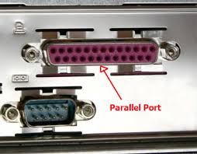

Slide 35
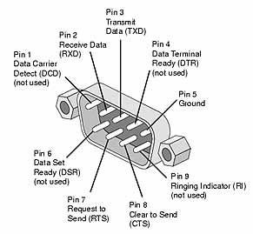

Slide 37
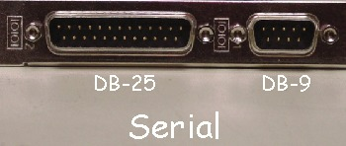

Slide 38
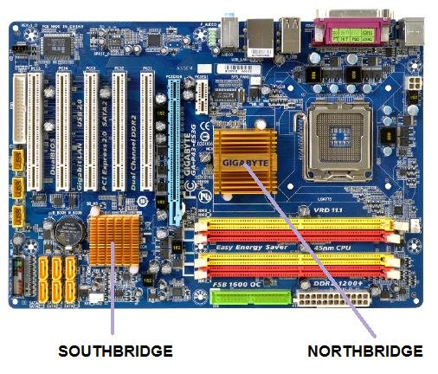

Slide 39
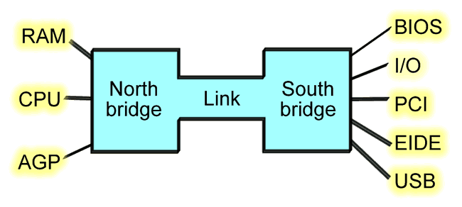

Slide 40
NORTH BRIDGE OF THE MOTHERBOARB
This a chip in the core logic chipset architecture on the northern section of the computer motherboard
A Southbridge is a chip in the core logic chipset architecture on the southern section of the computer motherboard

